Slide 1
MUTHAYAMMAL ENGINEERING COLLEGE DEPAERTMENT OF MEDICAL ELECTRONICS Electromyography 10/9/2019 A.SIVA SANKAR AP/MDE

Slide 2
Outline
Muscle Moment – Moment Arm
Review of Muscle Contraction Physiology
Physiological Basis of EMG
Methods of EMG Collection
Limitations & Uses
(DHHS 91-100 chapter 2 and 5)
Journal of Electromyography and Kinesiology (full-text in ScienceDirect)

Slide 3
What is EMG
Muscle contraction due to a change in the relative sliding of thread-like molecules or filaments
Actin and Myosin
Filament sliding is triggered by electrical phenomenon (ACTION POTENTIAL, AP)
The recording of muscle APs is called electromyography (EMG)
The record is known as an electromyogram

Slide 4
Action Potential (AP)
Cell membrane separates intracellular from extracellular space, diffusion barrier which restricts ION flow. Concentration of ions different inside vs. outside of cell membrane, results in an electrical potential difference known as a MEMBRANE POTENTIAL. Typical magnitude of membrane potential is -60 and -90 mV (interior of cell is negatively charged compared to the outside) when the muscle cell is in resting state.
When sufficient neurotransmitters are deposited at the motor endplate, it opens up Na+ gates, causing an influx of Na+ ions, causing a rapid depolarization of the membrane near the motor end plate. The membrane potential can change to +20 to +50 mV at the motor endplate within a fractions of a second, which starts (all or none) a cascade of events.

Slide 5
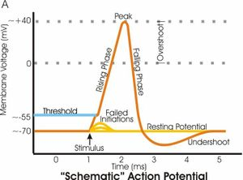
Action Potential (continued)
http://upload.wikimedia.org/wikipedia/en/thumb/7/78/Apshoot.jpg/300px-Apshoot.jpg

Slide 6
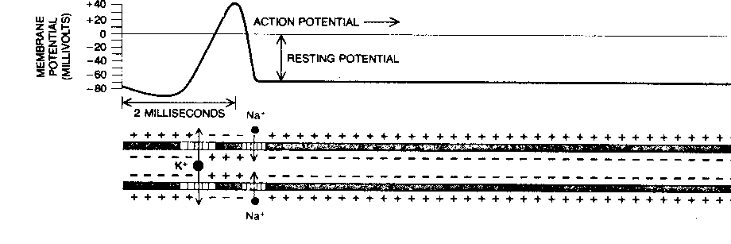
AP Continued
This changed potential, sets up local currents in adjacent areas of membrane, which opens up more Na+ gates at the adjacent areas of the membrane, depolarizing those areas. The newly depolarized areas sets up electrical current with adjacent areas, and thus the depolarization wave propagates along the entire length of the muscle cell.
Shortly after depolarization, the membrane is again repolarized, by active transport (ATP expenditure) of ions across the membrane. As a result a repolarization wave follows the depolarization wave for the entire length of the muscle.

Slide 7
Action Potential Summary
Active response of excitable membranes in nerve and muscle fibers produced by sodium and potassium channels opening in response to a stimulus
AP abide by the all-or-none principle
If MP reaches threshold voltage then Na⁺ channels open at first (Which direction will Na⁺ flow?)
Na⁺ channels only open for 1 ms, this causes repolarization (K⁺ channels also open during this time to speed up return of resting membrane potential)
AP propagation along muscle fibers
AP propagation velocity dependent upon:
(1) diameter of fibers (faster for thick – fast twitch)
(2) [K⁺] in extracellular fluid, ie chemical environment.

Slide 8
Motor Unit Action Potential
Typically, each motorneuron innervates several hundred muscle fibers (innervation ratio)
Motor Unit Action Potential (MUAP) = summed electrical activity of all muscle fibers activated within the motor unit
Muscle force increased through higher recruitment and increased rate coding

Slide 9
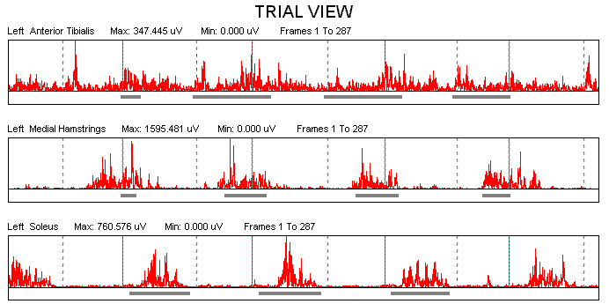
Recording Methodology
Sweep of AP → similar to a wave
Height of wave and the density of the wave can be recorded
Represented graphically → electromyogram

Slide 10
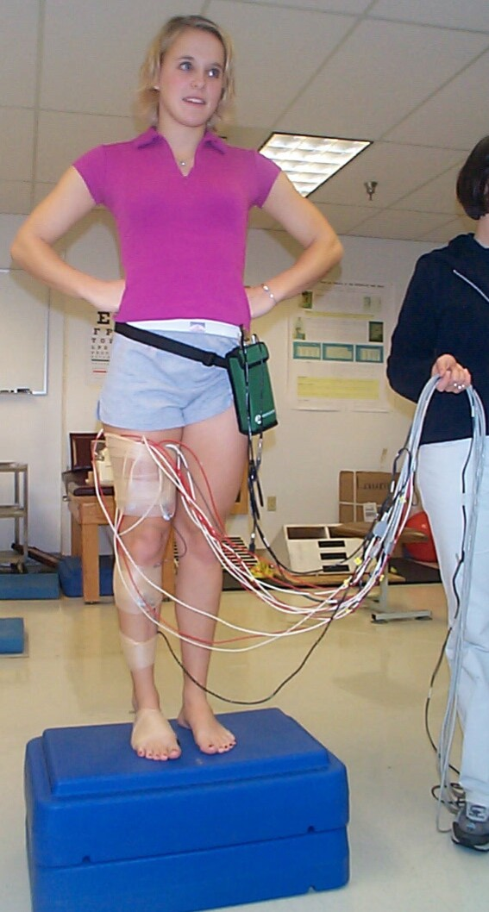
Recording Methodology (continued)
Electrical potential difference measured between two points → bipolar electrode configuration used
Bipolar Electrode Types
Fine Wire
Needle
Surface
Most common, less invasive
Silver-silver chloride electrodes
Electrode Placement
Overlying the muscle of interest in the direction of predominant fiber direction
Subject is GROUNDED by placing an electrode in an inactive region of body
http://www.hhdev.psu.edu/atlab/EMG.jpg

Slide 11
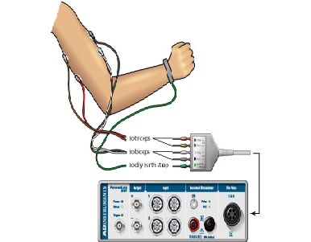
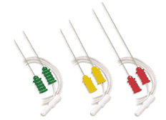
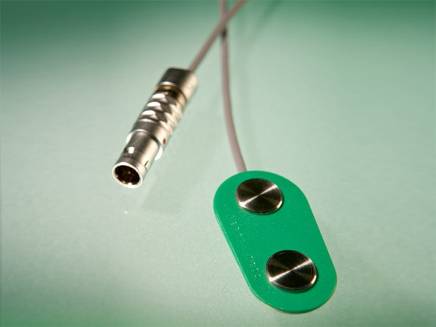
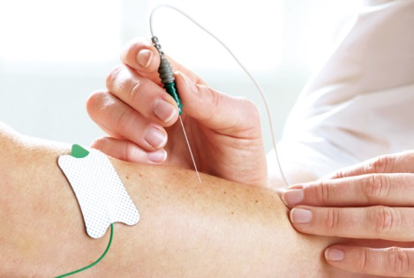
EMG Electrodes
Fine wire
Needle electrode
Surface Electrodes

Slide 12
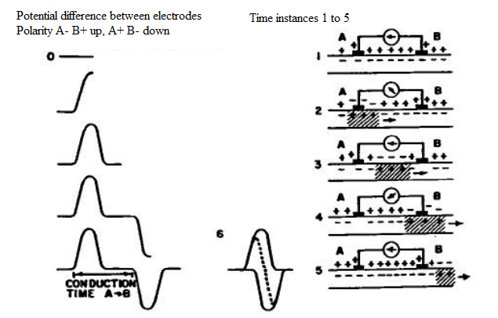
Physiological Basis
Hypothetical EMG from a single Muscle cell

Slide 13
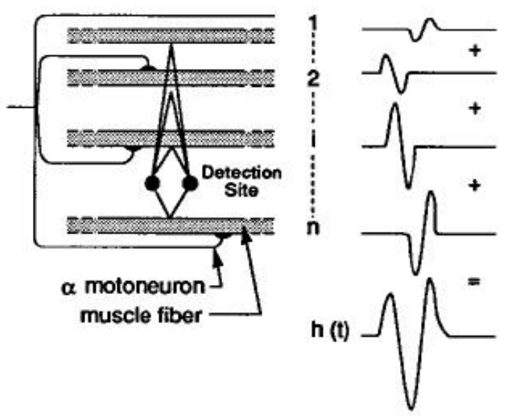
Physiological Basis
Hypothetical EMG from a Motor unit

Slide 14
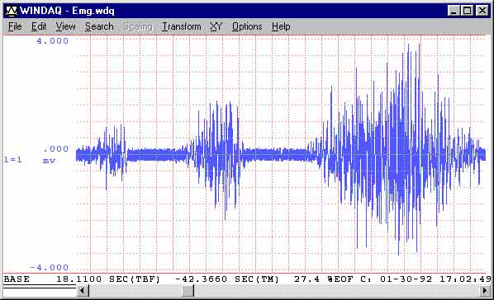
Typical EMG recording
Amplitude (mv)→
Time axis (msec) →
Average amplitude over a time interval = 0

Slide 15
Analyzing the EMG Signal
Amplitude & Frequency
More MU → more amplitude, more spikes and more turns in signal
Change in firing rate → change in frequency content of EMG
Change in muscle fiber type → change in AP velocity, change in EMG frequency.
EMG is spatial and temporal summation of APs

Slide 16
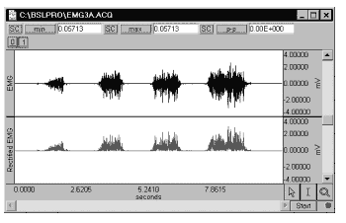
Average Rectified Amplitude
Rectified = all negative values converted to positive values (absolute value)
Then the average rectified amplitude provides a measure of signal strength

Slide 17
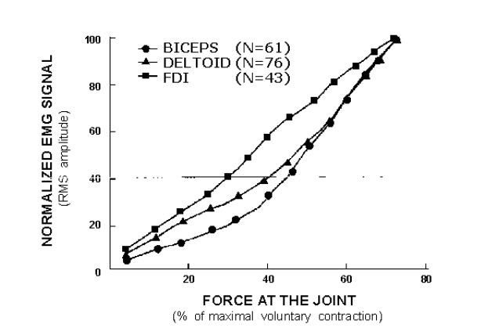
EMG Amplitude vs Muscle Contraction Intensity
Amplitude increases with increased contraction intensity, BUT it is not a linear relationship

Slide 18
RMS Amplitude
RMS (Root Mean Square):
Each data point is squared and thus the negative values becomes positive.
Mean is determined from the squared values
Square root of this mean is RMS

Slide 19
Factors Influencing Signal Measured
Geometrical & Anatomical Factors
Electrode size
Electrode shape
Electrode separation distance with respect to muscle tendon junctions
Thickness of skin and subcutaneous fat
Misalignment between electrodes and fiber alignment
Physiological Factors
Blood flow and temperature
Type and level of contraction
Muscle fiber conduction velocity
Number of motor units (MU)
Degree of MU synchronization

Slide 20
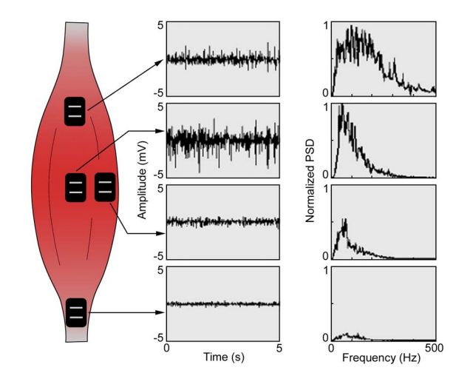
Effect of electrode position on EMG

Slide 21
Normalization
Def: calibration against a known reference
This allows researchers ability to compare different activities for the same muscle, different muscles, activities on different days, different subjects for same or different tasks, etc.
Choices of normalization
Maximum voluntary contraction (MVC)
Functional activty
Isometric activty
Unresisted normal activity
Submaximum contraction
Limitations
Variability of force generation due to motivation/physiological reasons

Slide 22
What can be learned from an EMG?
Time course of muscle contraction
Contraction force
Coordination of several muscles in a movement sequence
These parameters are DERIVED from the amplitude, frequency, and change of these over time of the EMG signal
Field of Ergonomics: from the EMG conclusions about muscle strain and the occurrence of muscular fatigue can be derived as well

